Slide 1
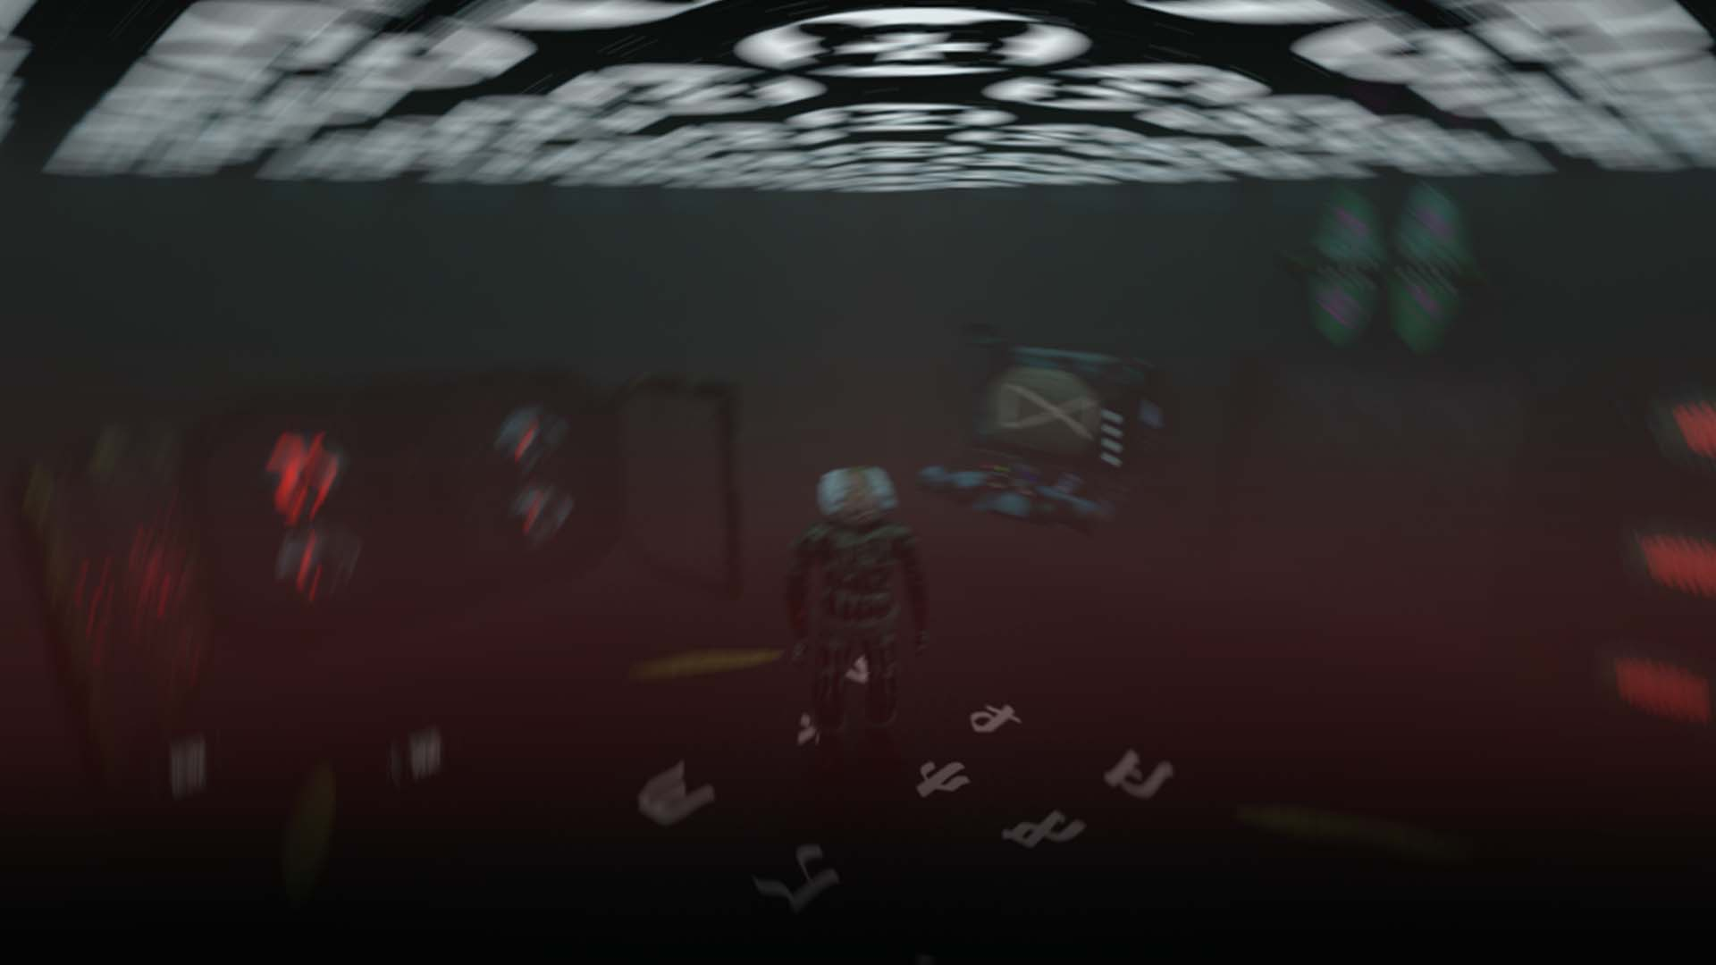






Multiplayer / CO-OP / Horror / Escape Room
We are a seven-person team from Portugal with backgrounds as masters in software engineering and degrees in videogames.
We set out to create new and enticing experiences and rely on industry mentors to advise us.
Filipe Coelho
Bruno Costa
Alexandre Silva
André Coelho
Game Producer
Lead Programmer
Game Director
Game Designer
Game Programmer
Sound Designer
Rami Ismail
consulting through course
Multiplayer / CO-OP / Horror / Escape Room
Nuno Coelho
Romeu Neto
Fábio Monteiro
2D Artist
3D Artist
3D Artist
VFX Artist
3D Artist
Video Artist
Confidential – Intended for viewing by publishers only

Slide 2
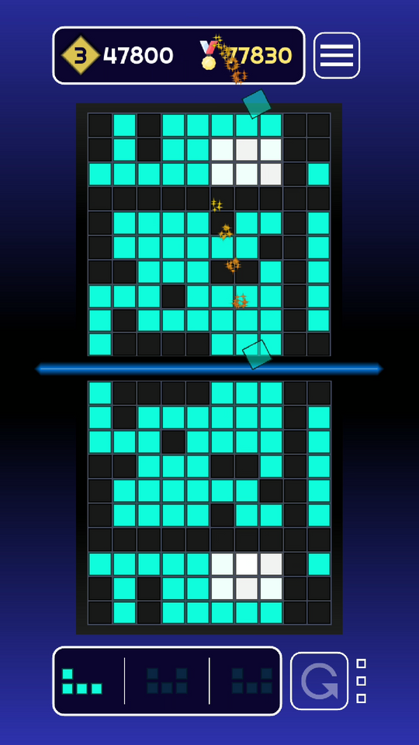


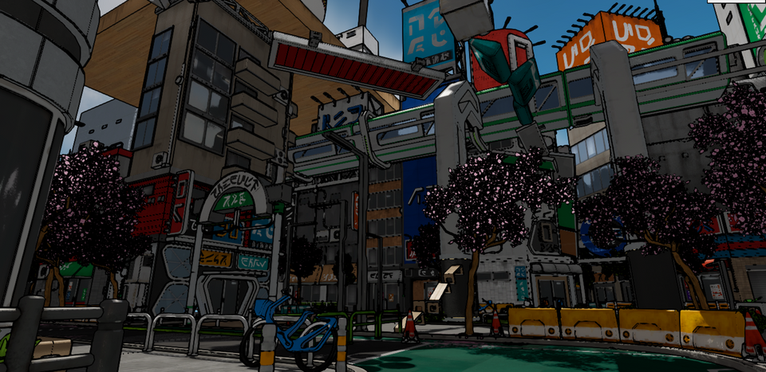



Meet the studio
We are a seven-person team from Portugal with backgrounds as masters in software engineering and degrees in videogames.
We set out to create new and enticing experiences and rely on industry mentors to advise us.
Flat Fat Fartfest
Filipe Coelho
Bruno Costa
Alexandre Silva
André Coelho
🔗Mirage Blocks Official Website
Game Producer
Lead Programmer
Game Director
Game Designer
Game Programmer
Sound Designer
Rami Ismail
consulting through course
Nuno Coelho
Romeu Neto
Fábio Monteiro
2D Artist
3D Artist
3D Artist
VFX Artist
3D Artist
Video Artist
Coming Soon
Notes:
Q: The team does not have exp in gamedev industry. Should put other exp like college projects or work at software dev?
TODO: Add photos

Slide 3
Meet the studio
Project S.T.O.R.M. began with a team of three programmers and a puzzle designer.
We focused on our strengths and started developing a puzzle game with a strong emphasis on systems.
Flat Fat Fartfest
Our goal was to create procedurally generated levels, rooms, and puzzles to keep the gameplay fresh and engaging.
🔗Mirage Blocks Official Website
Additionally, we chose to make the game a multiplayer co-op experience to add more depth to the gameplay.
It always requires two players and leverages their communication to fit puzzle pieces together and find solutions to the rooms.
Coming Soon

Slide 4
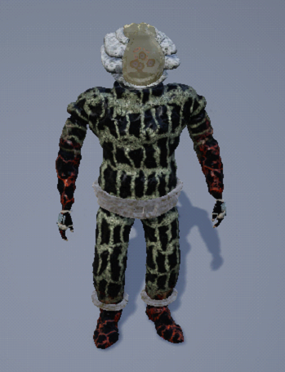
Why Project S.T.O.R.m.
Project S.T.O.R.M. began with a team of three programmers and a puzzle designer.
We focused on our strengths and started developing a puzzle game with a strong emphasis on systems.
Our goal was to create procedurally generated levels, rooms, and puzzles to keep the gameplay fresh and engaging.
Additionally, we chose to make the game a multiplayer co-op experience to add more depth to the gameplay.
It always requires two players and leverages their communication to fit puzzle pieces together and find solutions to the rooms.
This game capitalizes on the post-pandemic boom in multiplayer games with carefully designed cooperative gameplay.
There are also collectible narrative elements and hidden cutscenes to uncover the mystery, appealing to collectors.
Support for user-generated content, including puzzle editors and integrations with the Steam Workshop expands the playtime of the game.
The game features multiple modes with varying lengths and difficulties.
Notes:
Can’t think of a strong artistic why

Slide 5
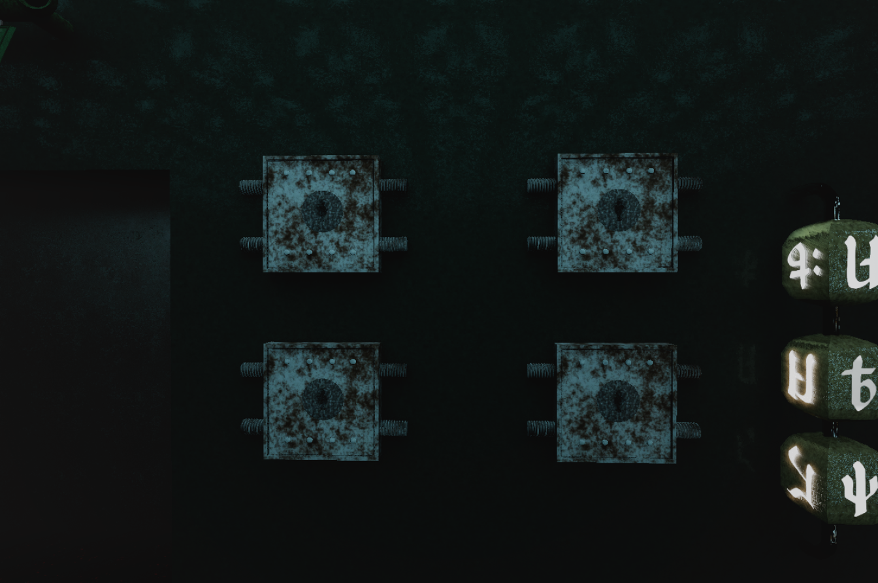
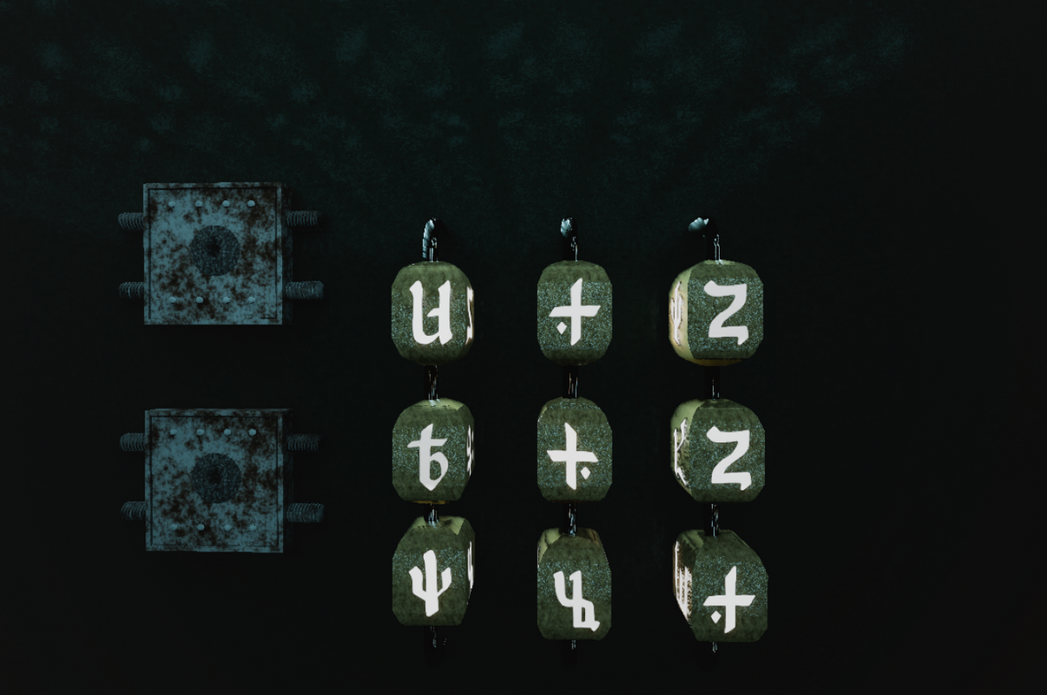
Why Project S.T.O.R.m.
Horror, Co-op & Escape Room… Procedurally Generated!
This game capitalizes on the post-pandemic boom in multiplayer games with carefully designed cooperative gameplay.
A procedurally generated multiplayer escape room game that relies heavily on players’ cooperation and communication.
There are also collectible narrative elements and hidden cutscenes to uncover the mystery, appealing to collectors.
Support for user-generated content, including puzzle editors and integrations with the Steam Workshop expands the playtime of the game.
Each lobby selects their type of game:
Rooms change in shape and size;
Puzzles vary in difficulty and solutions;
Games differ in duration;
The game features multiple modes with varying lengths and difficulties.
Discover hidden lore pieces and unlock cutscenes to uncover the secrets of the place you’re trapped in.

Slide 6
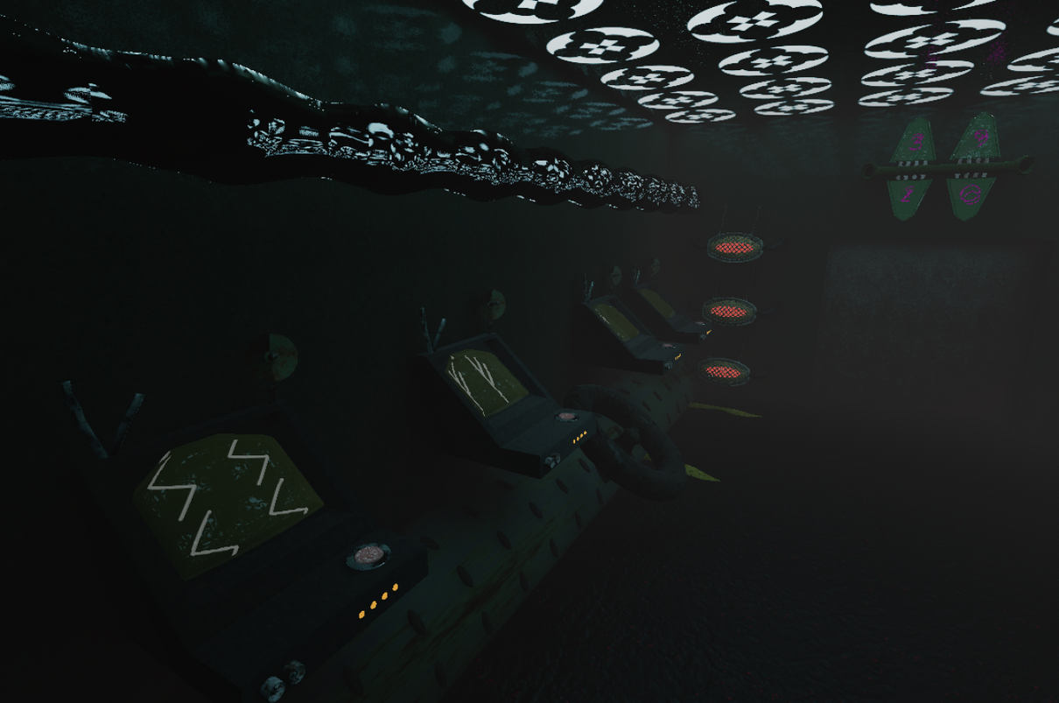
What is Project S.T.O.R.m.
Horror, Co-op & Escape Room… Procedurally Generated!
A procedurally generated multiplayer escape room game that relies heavily on players’ cooperation and communication.
Each lobby selects their type of game:
Rooms change in shape and size;
Puzzles vary in difficulty and solutions;
Games differ in duration;
Discover hidden lore pieces and unlock cutscenes to uncover the secrets of the place you’re trapped in.

Slide 7
What is Project S.T.O.R.m.
Co-op Escape Room: Players are placed in separate rooms, each with parts of the puzzle to solve (either information or actions).
Demo: The playable demo consists of three different rooms per player, each containing three puzzles, for a total playtime of 30 to 45 minutes. Matchmaking is done through Steam.
Procedural generation systems: Already in development. Rooms can change their shape to accommodate the necessary puzzles, and the puzzles themselves variable solutions.
VR Support: The game supports virtual reality headsets through SteamVR™ with PC crossplay. Each player can choose to play either on a computer or in virtual reality.

Slide 8
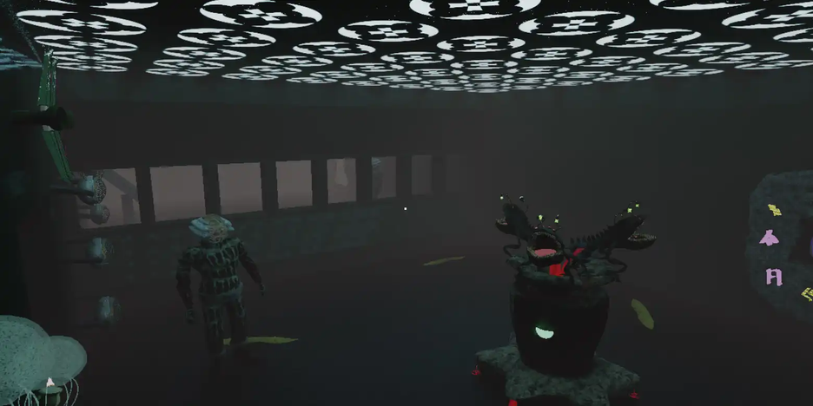
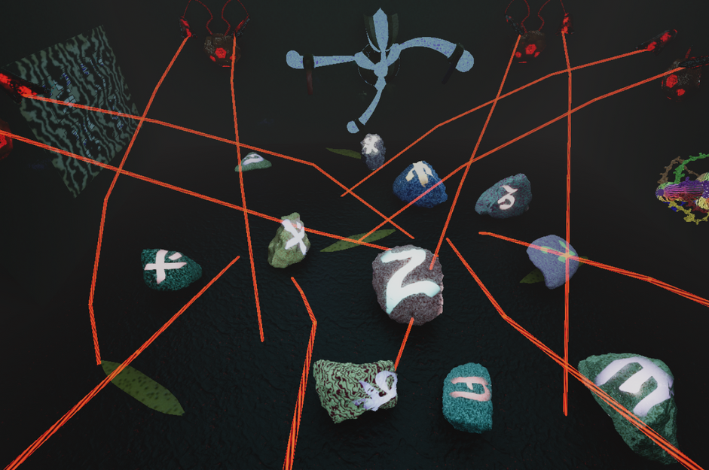
The Idea of Project S.T.O.R.M.
Stressors
With the time limit pressure, the game also introduces other stress-inducing elements over time like knocks sounds or eerie creatures lurking outside in the water. In this horror, mysterious, suspenseful, and thrilling setting, players are put in stressful situations while needing to communicate clearly and solve puzzles.
2v2 Battles
Team up with your friend against another lobby of two players. Both groups solve identical puzzles, racing to be the first to escape the facility!
Time Trials
Clear all rooms before the time runs out!
The time varies with the number of rooms and the difficulty selected by the lobby.
Community Experiences
Hand-crafted rooms created by the community, featuring a curated selection of puzzles and environments.
Speed Runs
Unlimited Replayability
By combining procedural generation and selection of puzzles and rooms with user-generated content, this game has the potential to offer near-infinite gameplay.
When considering that every player will need a friend to solve the puzzles, each experience will always be different, even in similar scenarios.
Clear as many rooms as you can within the given time! This is perfect for players who enjoy speed running games or seek an additional challenge within the game.
VR Crossplay
The game supports virtual reality headsets through SteamVR™ with PC crossplay. Each player can choose to play either on a computer or in virtual reality.

Slide 9
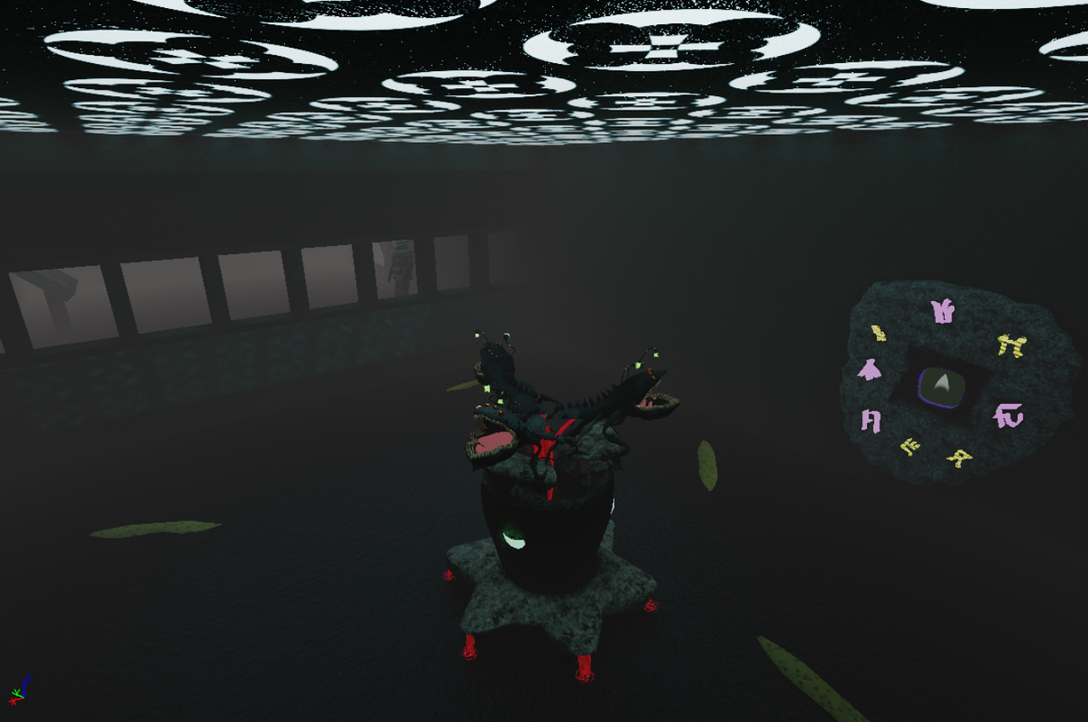
Game Modes
2v2 Battles
Team up with your friend against another lobby of two players. Both groups solve identical puzzles, racing to be the first to escape the facility!
Time Trials
Clear all rooms before the time runs out!
The time varies with the number of rooms and the difficulty selected by the lobby.
Community Experiences
Hand-crafted rooms created by the community, featuring a curated selection of puzzles and environments.
Marathon
Clear as many rooms as you can within the given time! This is perfect for players who enjoy speed running games or seek an additional challenge within the game.

Slide 10
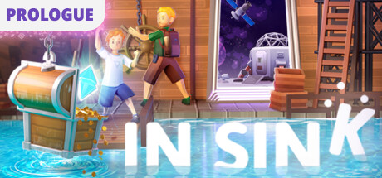

Comparative Analysis
Game A
In Sink: A Co-Op Escape Prologue
The Room 4: Old Sins
💬 1234 🛒 55k 💰 $280k
💬 1409 🛒 70.5k 💰 $493k
💬 7261 🛒 363k 💰 $1.4M
June 10, 2024
June 10, 2024
June 10, 2024
Information extracted through Boxleiter method

Slide 11
Timeline
NOW
Launch
1 Year
6 Months
1 Year
4 Months
2 Months
Vertical Slice
Feature Complete
Content Complete
Prototype
MVP

Slide 12
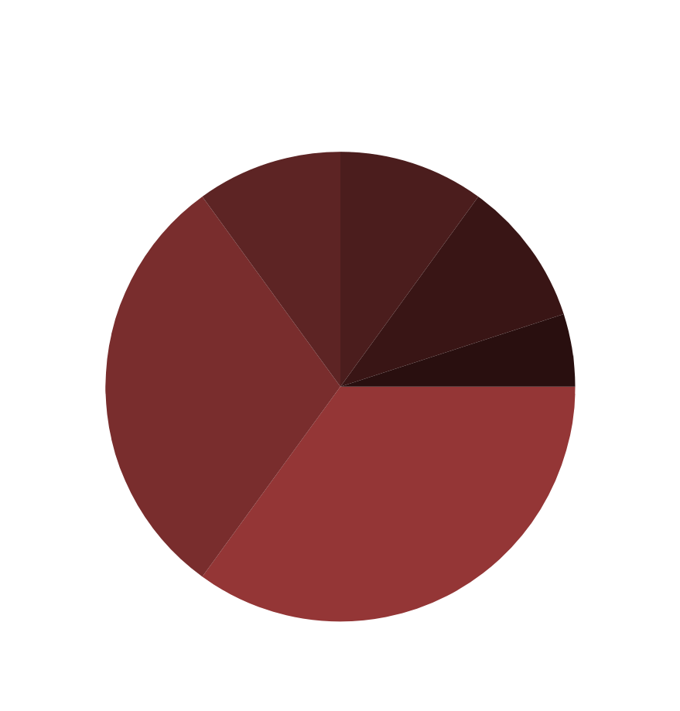
Timeline
NOW
Launch
Total Asking Budget: $ 350.000
Target Price: $16.99
Break-even: 295k units
1 Year
6 Months
1 Year
4 Months
2 Months
Vertical Slice
Feature Complete
Content Complete
Prototype
MVP

Slide 13



Budget
Total Asking Budget: $ 350.000
Target Price: $16.99
Break-even: ~30k units
Budget: $350.000
Genres: Co-op / Puzzle / Thriller / Escape Room
Release Date: Q2 2027
Platforms: PC / SteamDeck™ / SteamVR™
Aditional Content:
Official Website (build available)
GDD
OneSheet
Notes:
This budget seems low for 2 years

Slide 14

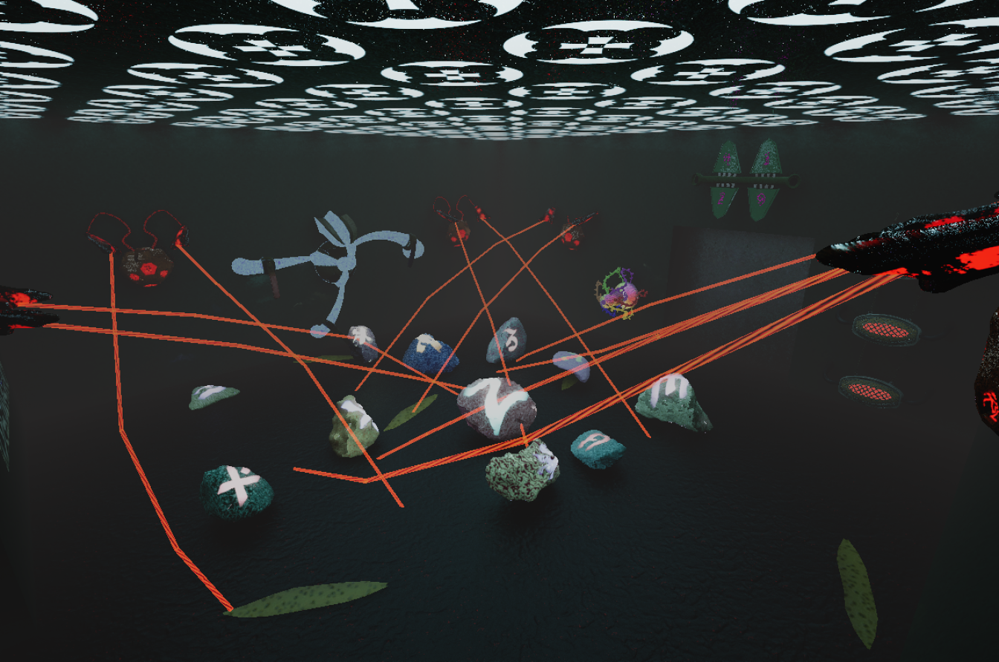

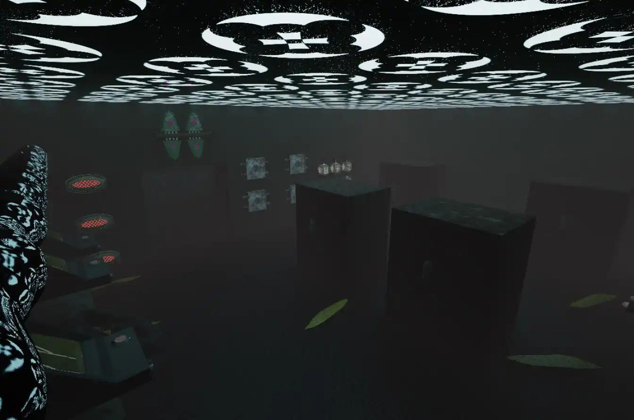
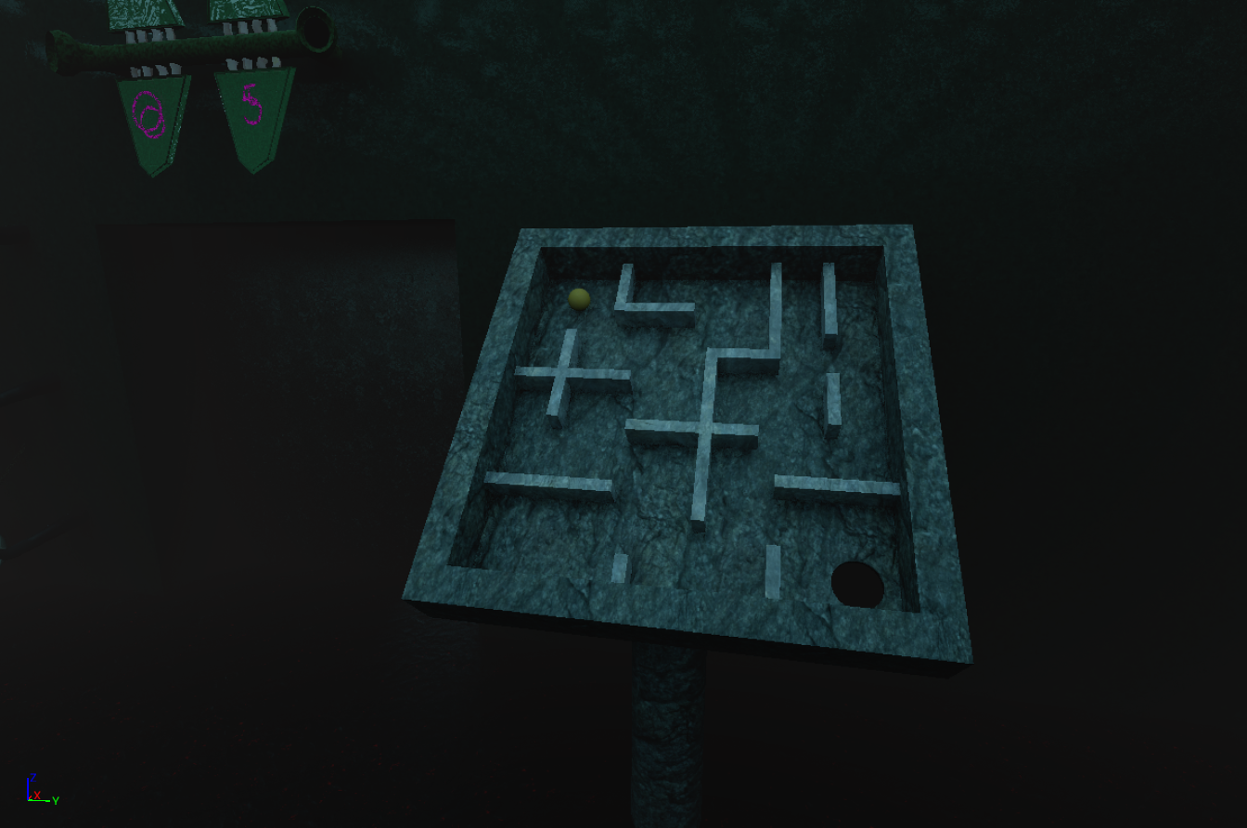
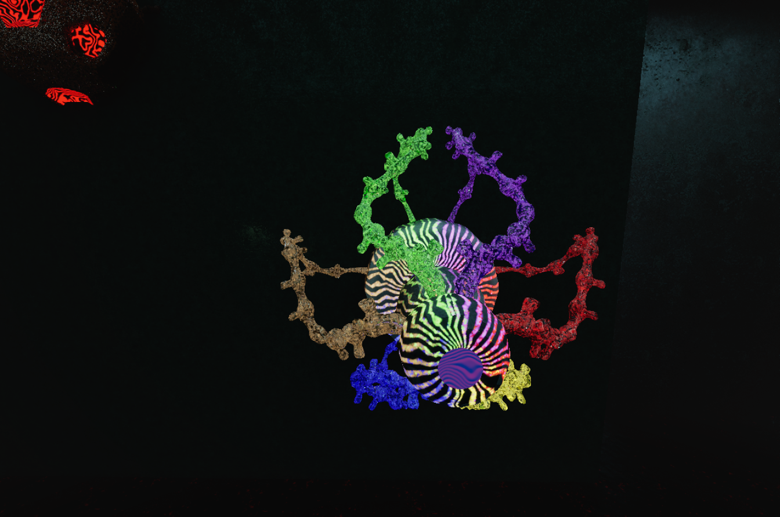
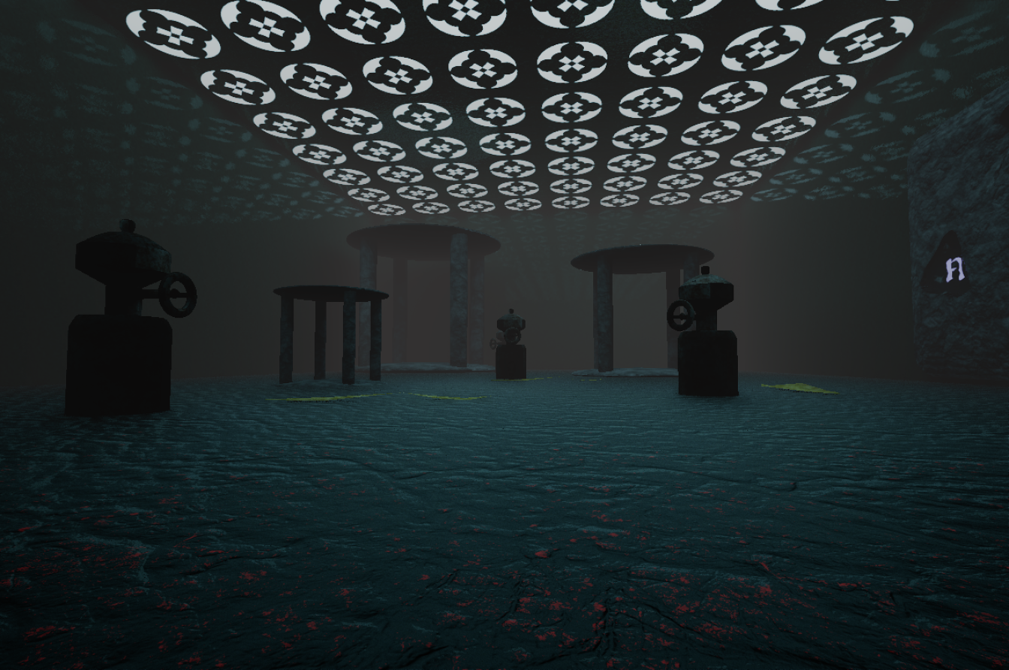
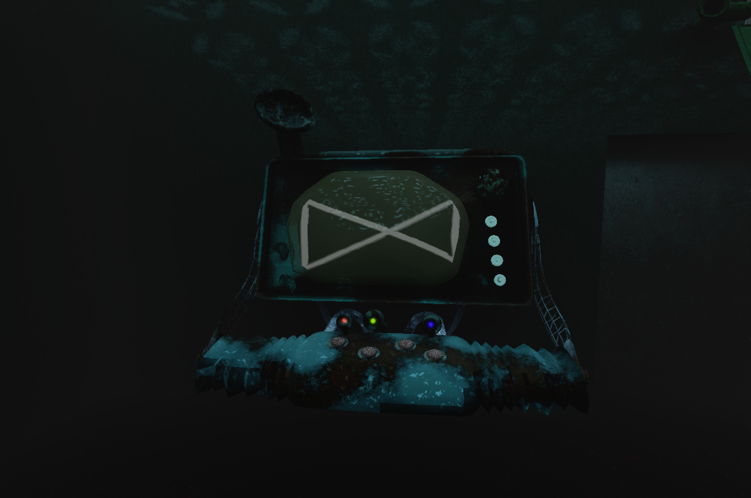
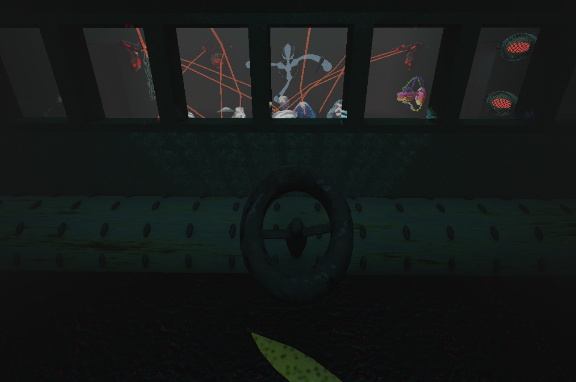

Summary
Total Asking Budget: $ 350.000
Target Price: $16.99
Break-even: 295k units
Budget: $350.000
Genres: Co-op / Puzzle / Thriller / Escape Room
Release Date: Q2 2027
Platforms: PC / SteamDeck™ / SteamVR™
Aditional Content:
Official Website (build available)
GDD
OneSheet

Slide 15
THANK YOU!
🔗https://sinkingcodfish.github.io
✉️ business@sinkingcodfish.com
Filipe Coelho
✉️ filipe.coelho@linovt.com

